Slide 1
TEAM NAME: I-SARA
H
K
Team Number: 4
I
Name of Team Members:
Alisha Gupta | Aman Srivastava | Ishant Singh | Raghav Gupta | Soumyadiya Ganguly |

Slide 2
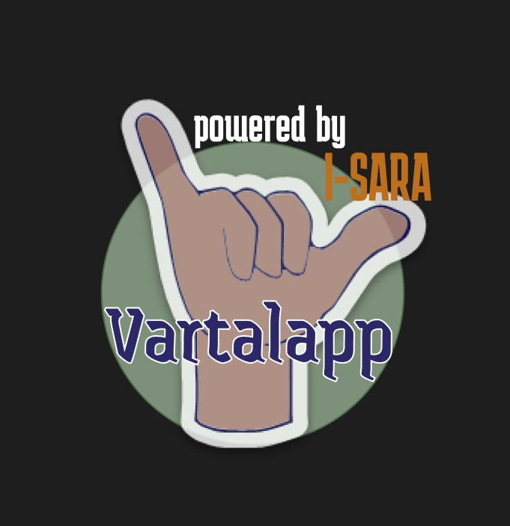

Slide 3
Problem Statement
Our focus:
Digital Transformation & Technology Innovation
Human Capital Development:
Education and Healthcare
We are addressing the communication gap between deaf and hard-of-hearing communities and the general population, which hinders seamless communication, resulting in isolation and limited self-expression.

Slide 4
Understanding of the Problem
01.
02.
03.
04.
Widespread Impact
Social Barriers
In India, approximately 63 million people (6% of the population) suffer from significant auditory loss.
This community faces barriers in education, employment, and daily interactions due to communication challenges.
Limited Solutions
Urgent Need
Q
Existing solutions are often expensive, not real-time, or require specialized hardware, limiting widespread adoption.
There's a pressing need for an accessible, affordable, and efficient communication tool to bridge this gap and promote inclusivity.

Slide 5
ABOUT SIGN LANGUAGES
About 1 billion people in the world live with disabilities
12.6 million
About these many people have absolute deafness
… among them, about 430 million have hearing loss

Slide 6
APPROACH
01.
02.
03.
04.
05.
06.
I
Research
User-Centered Design
Tech Selection
Study existing sign language translation technologies and their limitations.
Engage with deaf communities to understand their specific needs and challenges.
Choose appropriate CV and NLP technologies for accurate real-time translation.
Prototype
Iteration
Scalability
Create a minimum viable product (MVP) for testing.
Continuously refine the solution based on user feedback.
Design for multi-language support and potential expansion to other regions in India.

Slide 7
Inspiration from a Developed Country
United States - specifically, the development of SignAll, a sign language translation technology.
Adaptation to Indian Context
Strategies to Adapt
Use of AI and machine learning for real-time translation
Integration with everyday devices (smartphones, tablets)
Collaboration with deaf communities for continuous improvement
Include support for Indian Sign Language (ISL) and major regional languages
Optimize for low-bandwidth areas and entry-level smartphones
Incorporate culturally relevant gestures and expressions

Slide 8
Proposed Solution
C
Vartalapp:
An intuitive, multilingual platform for two-way and mass communication between sign language users and others.

Slide 9
KEY FEATURES
Translation
Animation
P
Real-time sign language to speech/text conversion.
Speech/text to sign language animation generation.
Language Support
Offline Accessibilty
M
Indian Sign Language and major spoken languages.
Functionality in areas with limited connectivity.

Slide 10



Technology Used
PyTorch
OpenCV
Natural Language Toolkit
Open-source machine learning framework for training and deploying neural networks for gesture recognition and tracking.
Computer vision library for real-time image processing, crucial for capturing and analyzing sign language gestures.
Leading platform for building Python programs to work with human language data, essential for text processing and generation.

Slide 11
Generative AI Implementation
Vartalapp uses Generative AI features to bridge the communication gap; keeping up with the latest technology.
Text and Speech
Image Processing
Use of NLP (Natural Language Processing) for creating coherent text and speech.
Implementation of reinforcement learning algorithms to continuously improve translation accuracy based on user feedback.
Use of GANs for real-time gesture interpretation.
Use of NER to understand context and nuances in both sign language and spoken/written language.

Slide 12
Impact of Solution
Innovation
Business Value
First comprehensive, real-time sign language translation platform tailored for Indian users
Novel use of AI to bridge communication gaps in real-world scenarios
Market potential: 63 million hearing-impaired individuals in India
Estimated market size: $500 million by 2047
Potential for expansion to other South Asian countries
Revenue streams: Freemium model, enterprise licenses for businesses and educational institutions
X
V

Slide 13
Implementation
R&D
UI Design
Test
Research sign language tech, develop recognition algorithms, and prototype.
Design accessible UI with real-time video and animations.
Test with users, gather feedback, and refine performance.
Scaling
Integration
Launch
Support Indian languages, offline mode, and low bandwidth optimization.
Ensure compatibility with messaging platforms for seamless communication.
Soft launch, gather feedback, and scale with continuous updates.

Slide 14

PEOPLE THAT USE SIGN LANGUAGE
5%
1%
Uses SL as first language
Hard of Hearing population
G
T

Slide 15

Thank You!!
Y

